Slide 1



MTA Turnstile
EDA Analysis
Dior Marketing
By Tamader AboAlhassan

Slide 2


Introduction
Marketing for the new perfume at the metro station

Slide 3
Goal :
To promote the Dior perfume
The motive to increase profits

Slide 4



Tools
Panads Datetime Matplotlib
Libraries :
Tools
Python
Jupyter
Word and powerpoint
IED :

Slide 5



Data
2021
May
June
July
August
01
03
Station
Date and Time
02
Entries

Slide 6


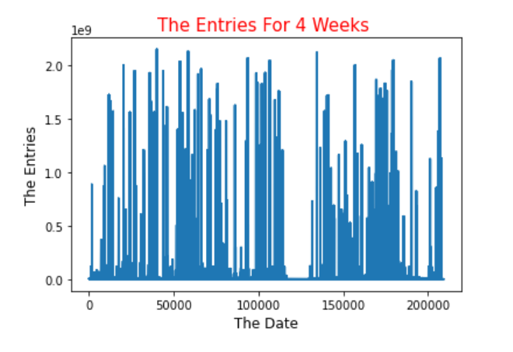



Ambiguous
Unclear
Unreadable

Slide 7
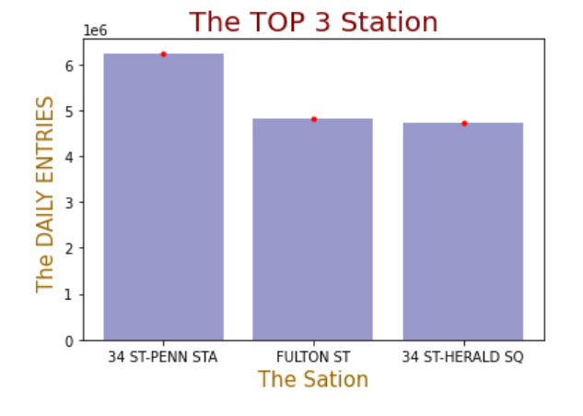
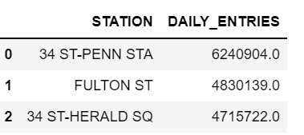

Slide 8
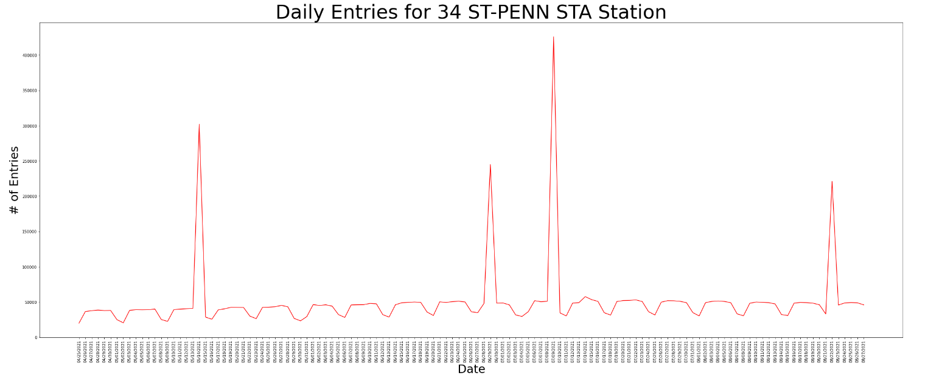
Date from May to Aug

Slide 9
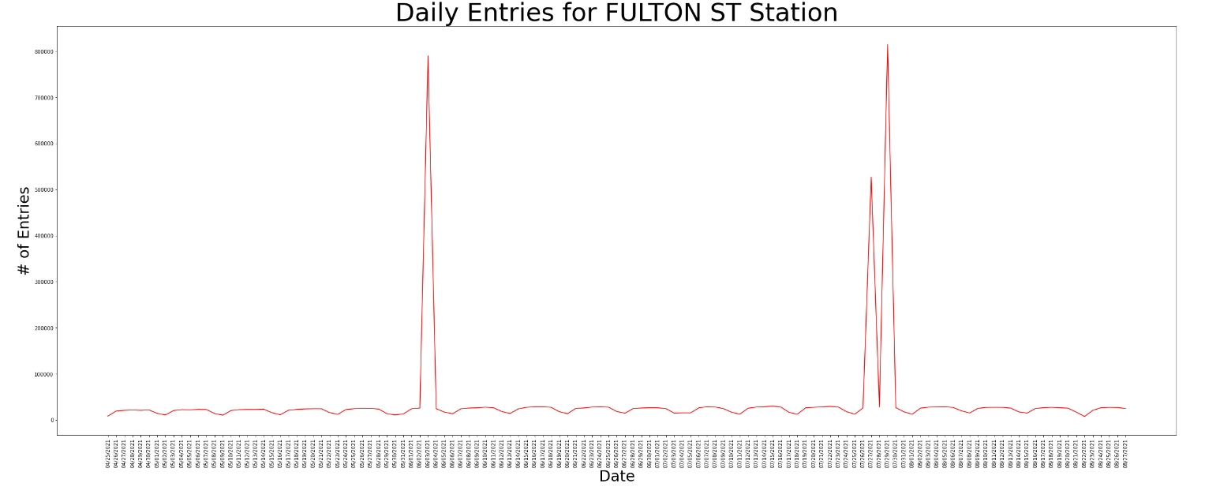
Date from May to Aug

Slide 10
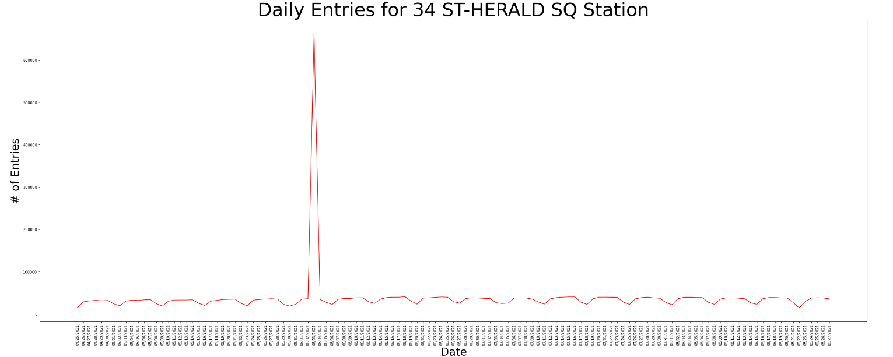
Date from May to Aug

